Slide 1

3. ANGLE MODULATION
KNUST
Telecom.
Engineering
Dr. M. S. Ellis smellis.coe@knust.edu.gh Department of Telecommunication Engineering Room 325

Slide 2
Introduction
In AM, the amplitude of the sinusoidal carrier is modulated by the sinusoidal message signal
There sinusoidal nature of the carrier shows that it can modulated in other ways
These are the frequency and phase
Therefore an opportunity to transmit a signal by modulating these two parameters presents itself
This method is called angle modulation

Slide 3
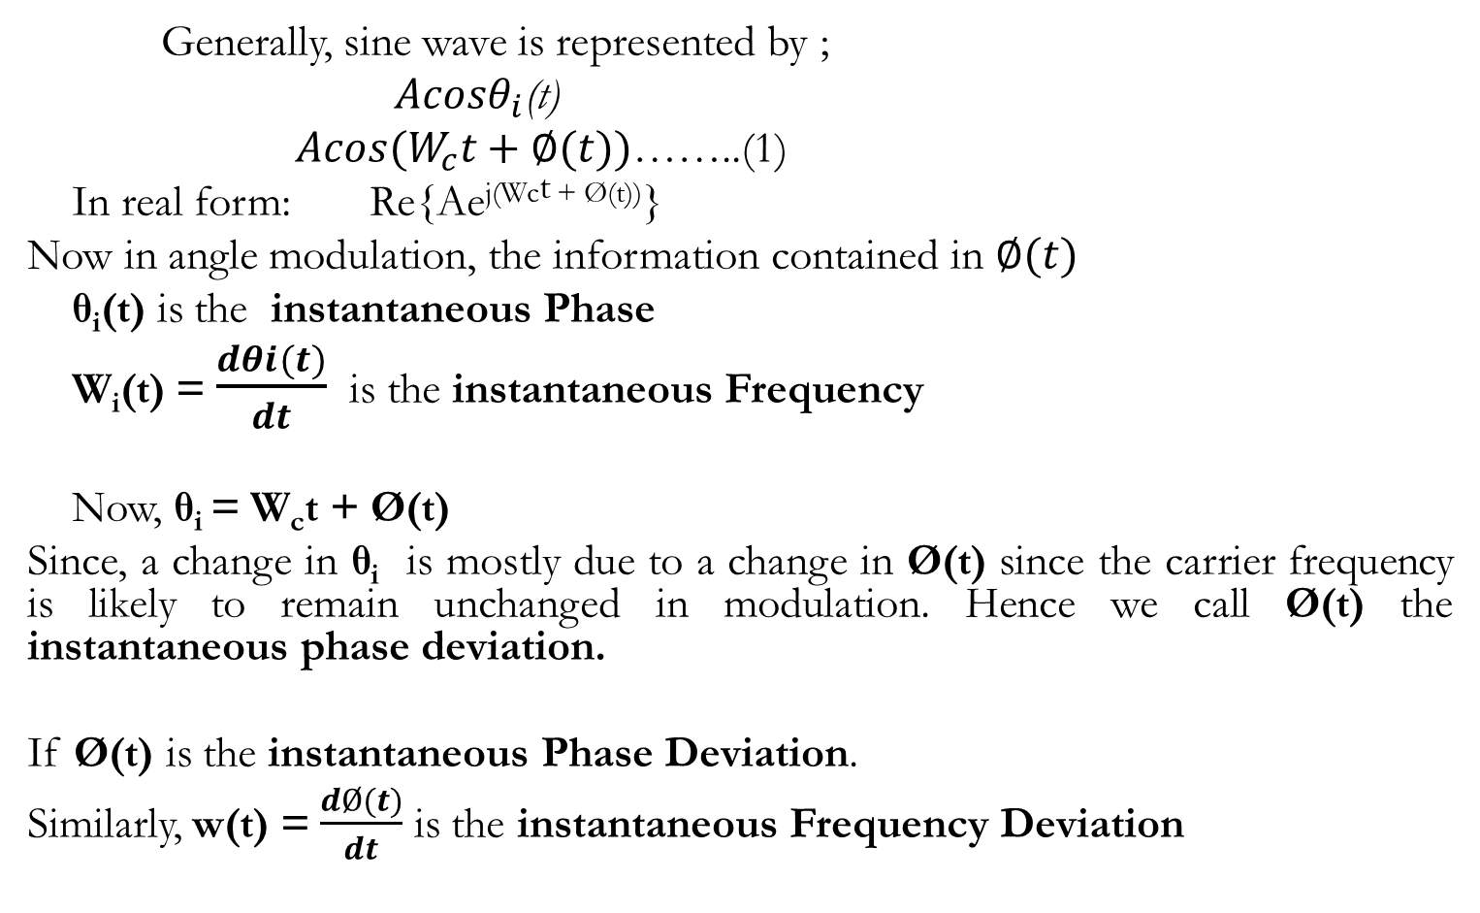
ANGLE MODULATION
Generally, sine wave is represented by ;
${Acosθ}_{i}$(t)
${Acos(W}_{c}t+∅(t))$……..(1)
In real form: Re{Ae^{j(Wct + Ø(t))}}
Now in angle modulation, the information contained in $∅(t)$
θ_{i}(t) is the instantaneous Phase
W_{i}(t) = $\frac{dθi(t)}{dt}$ is the instantaneous Frequency
Now, θ_{i} = W_{c}t + Ø(t)
Since, a change in θ_{i} is mostly due to a change in Ø(t) since the carrier frequency is likely to remain unchanged in modulation. Hence we call Ø(t) the instantaneous phase deviation.
If Ø(t) is the instantaneous Phase Deviation.
Similarly, w(t) = $\frac{dØ(t)}{dt}$ is the instantaneous Frequency Deviation

Slide 4
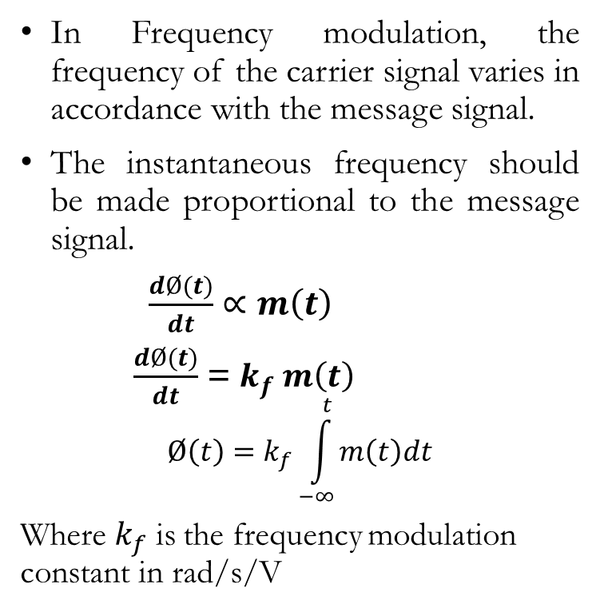
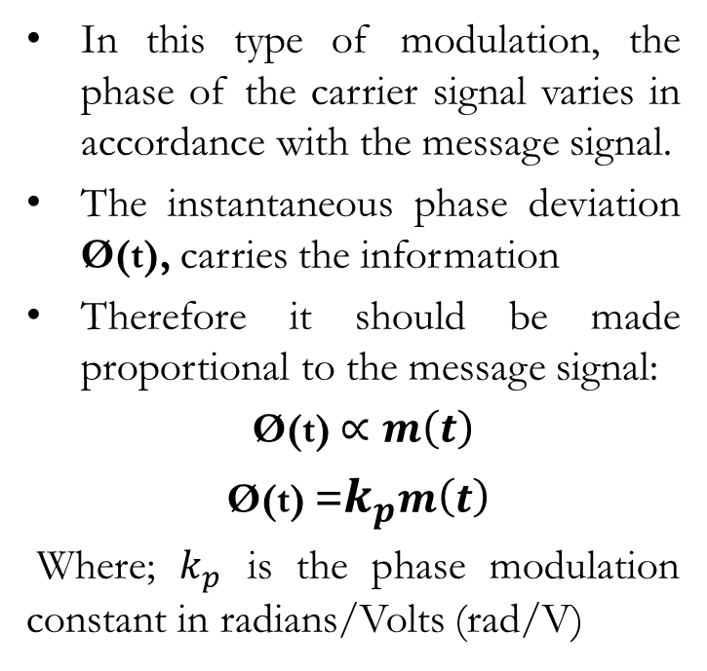
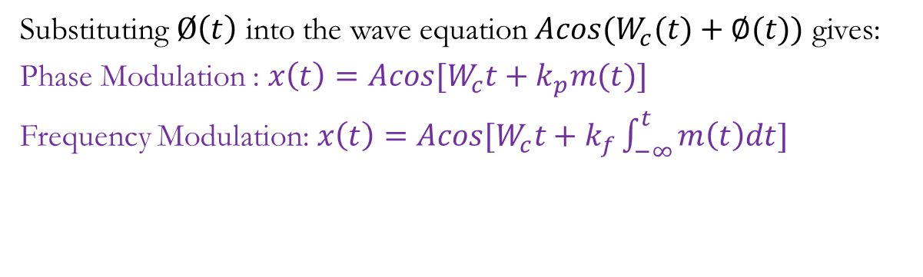
PHASE MODULATION
FREQUENCY MODULATION
In Frequency modulation, the frequency of the carrier signal varies in accordance with the message signal.
The instantaneous frequency should be made proportional to the message signal.
$\frac{dØ(t)}{dt}$ $∝m\left(t\right)$
$\frac{dØ(t)}{dt}$ = $k_{f} m\left(t\right)$
$$Ø\left(t\right)=k_{f}\int_{−∞}^{t}{m\left(t\right)dt}$$
Where $k_{f}$ is the frequency modulation constant in rad/s/V
In this type of modulation, the phase of the carrier signal varies in accordance with the message signal.
The instantaneous phase deviation Ø(t), carries the information
Therefore it should be made proportional to the message signal:
Ø(t) $∝m\left(t\right)$
Ø(t) =$k_{p}m\left(t\right)$
Where; $k_{p}$ is the phase modulation constant in radians/Volts (rad/V)
Substituting $Ø\left(t\right)$ into the wave equation ${Acos(W}_{c}(t)+∅(t))$ gives:
Phase Modulation : $x\left(t\right)=Acos[W_{c}t+k_{p}m(t)]$
Frequency Modulation: $x\left(t\right)=Acos[W_{c}t+k_{f}\int_{−∞}^{t}{m\left(t\right)dt}]$

Slide 5
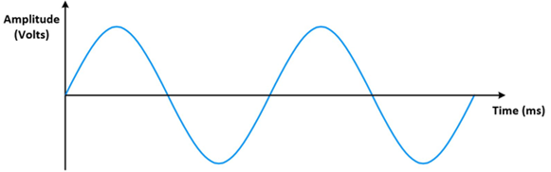
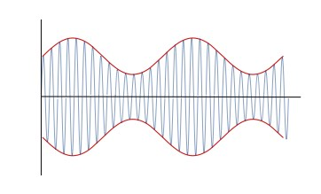
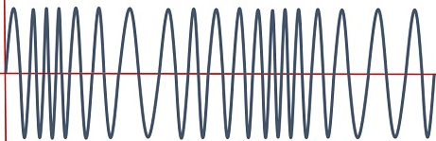
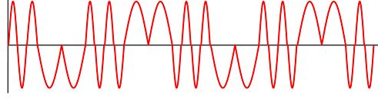
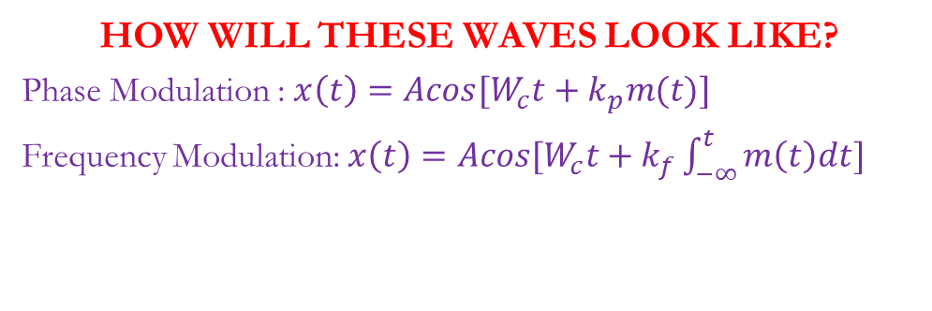
HOW WILL THESE WAVES LOOK LIKE?
Phase Modulation : $x\left(t\right)=Acos[W_{c}t+k_{p}m(t)]$
Frequency Modulation: $x\left(t\right)=Acos[W_{c}t+k_{f}\int_{−∞}^{t}{m\left(t\right)dt}]$
m(t)
AM
Class discussion:
Explain the differences between the 2 waveforms of FM and PM?
FM
PM

Slide 6
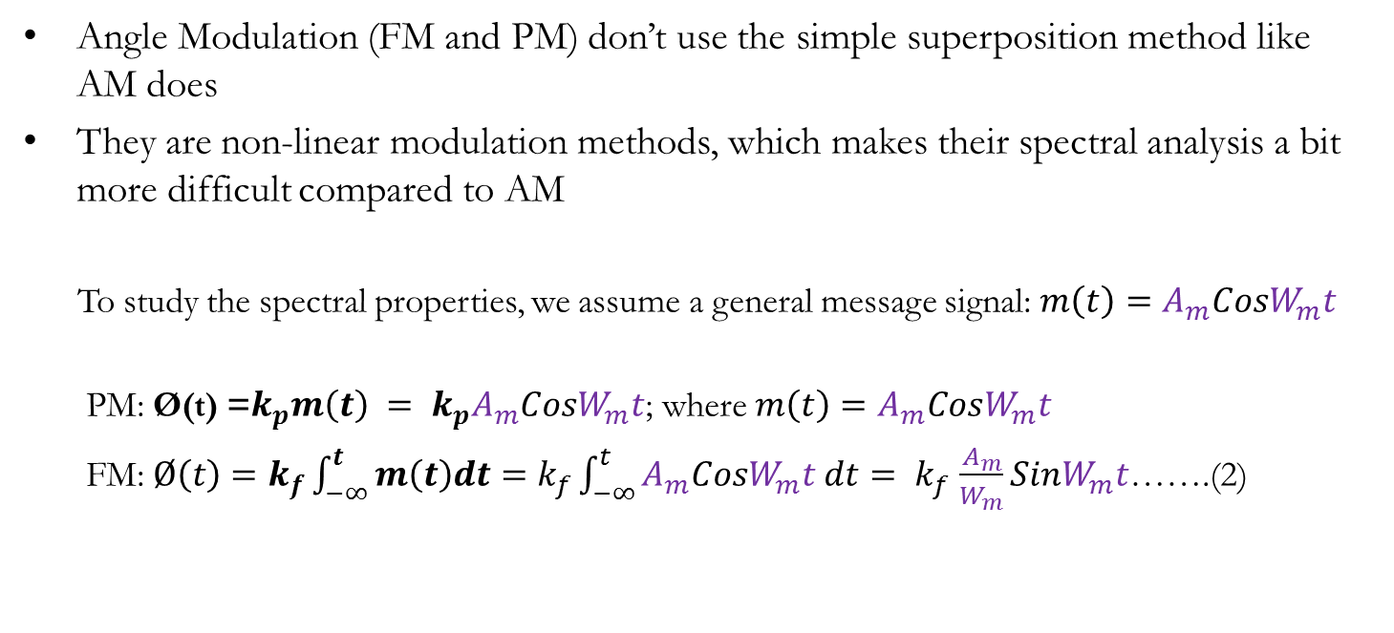
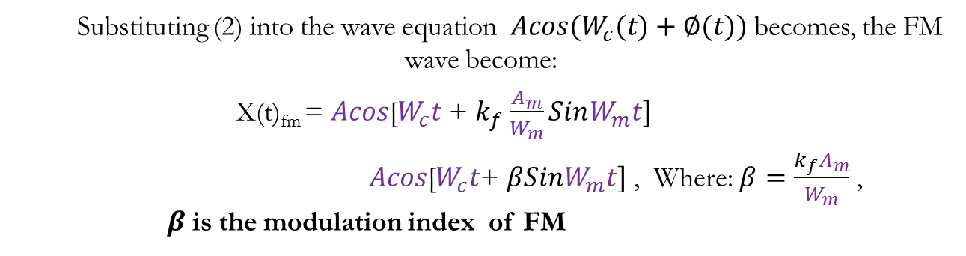
Spectral Properties (Bandwidth, Power)
Angle Modulation (FM and PM) don’t use the simple superposition method like AM does
They are non-linear modulation methods, which makes their spectral analysis a bit more difficult compared to AM
To study the spectral properties, we assume a general message signal: $m\left(t\right)=A_{m}CosW_{m}t$
PM: Ø(t) =$k_{p}m\left(t\right) = k_{p}A_{m}CosW_{m}t$; where $m\left(t\right)=A_{m}CosW_{m}t$
FM: $Ø\left(t\right)=k_{f}\int_{−∞}^{t}{m\left(t\right)dt}=k_{f}\int_{−∞}^{t}{A_{m}CosW_{m}t dt}= k_{f}$ $\frac{A_{m}}{W_{m}}SinW_{m}t$…….(2)
Substituting (2) into the wave equation ${Acos(W}_{c}(t)+∅(t))$ becomes, the FM wave become:
X(t)_{fm} = $Acos$[$W_{c}t$ + $k_{f}$ $\frac{A_{m}}{W_{m}}SinW_{m}t]$
$Acos$[$W_{c}t$+ $βSinW_{m}t]$ , Where: $β=\frac{k_{f}A_{m}}{W_{m}}$ , $β$is the modulation index of FM
What are the spectral quantities of this FM wave??

Slide 7
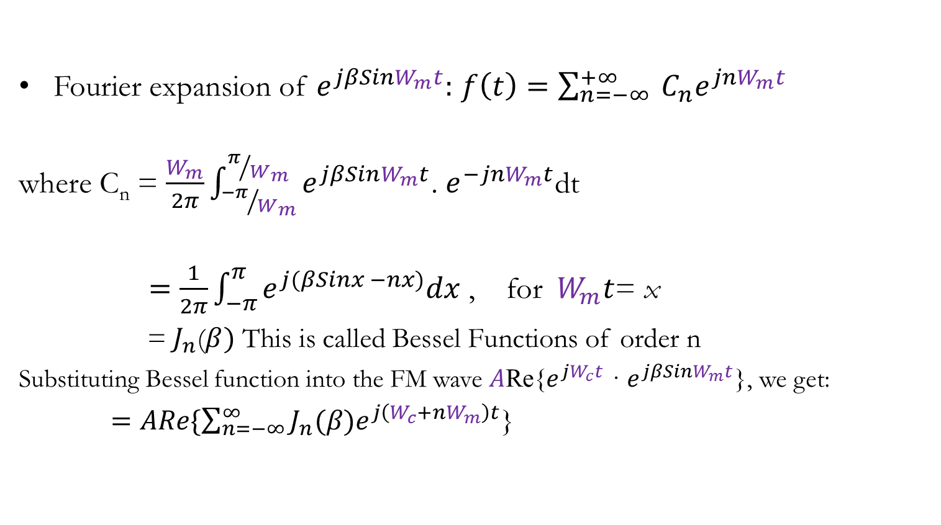
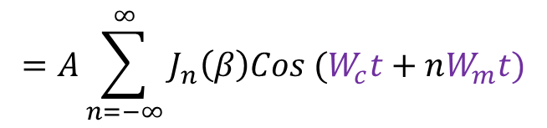
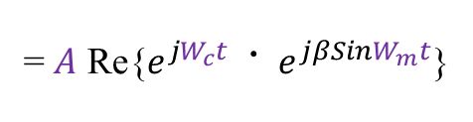

To study the spectral quantities we have break down the equation using Fourier Transform, as we did for AM
$FM WAVE: Acos$[$W_{c}t$+ $βSinW_{m}t]$
= $A$ Re{$e^{jW_{c}t}$ · $e^{jβSinW_{m}t}$}
Since $e^{jβSinW_{m}t}$is a periodic since wave. Fourier transforms is used to break it down:
Fourier expansion of $e^{jβSinW_{m}t}:$ $f\left(t\right)=\sum_{n=−∞}^{+∞}{ C_{n}e^{jnW_{m}t}}$
where C_{n} = $\frac{W_{m}}{2π}\int_{{−π}/{W_{m}}}^{π/{W_{m}}}{e^{jβSinW_{m}t}}$. $e^{−jnW_{m}t}$dt
$=\frac{1}{2π}\int_{−π}^{π}{e^{j(βSinx −nx)}dx}$ , for${ W}_{m}t$= x
= $J_{n}$($β)$ This is called Bessel Functions of order n
Substituting Bessel function into the FM wave $A$Re{$e^{jW_{c}t}$ · $e^{jβSinW_{m}t}$}, we get:
$=ARe\{\sum_{n=−∞}^{∞}{J_{n}(β)e^{j\left(W_{c}+nW_{m}\right)t}}$}
$$=A\sum_{n=−∞}^{∞}{J_{n}\left(β\right)Cos (W_{c}t+nW_{m}t)}$$
What spectral components can be found here?

Slide 8
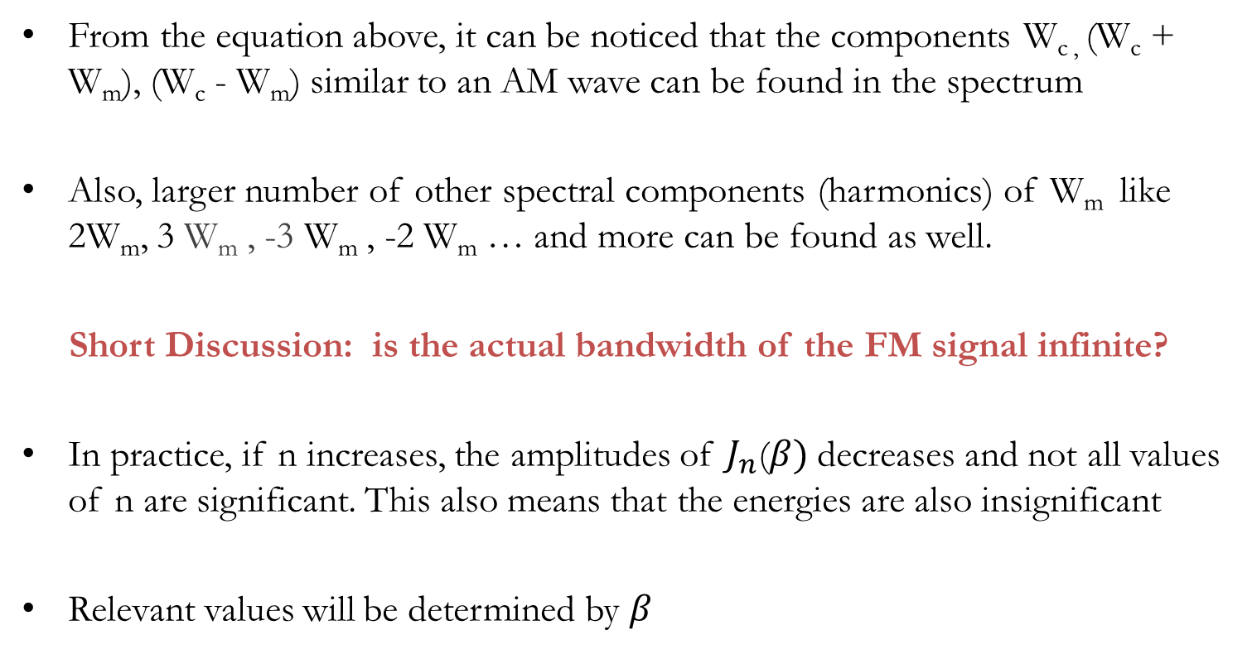
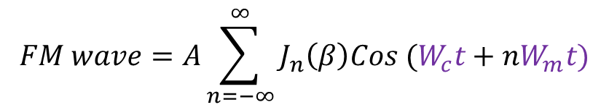
$$FM wave=A\sum_{n=−∞}^{∞}{J_{n}\left(β\right)Cos (W_{c}t+nW_{m}t)}$$
What spectral components can be found here?
From the equation above, it can be noticed that the components W_{c ,} (W_{c} + W_{m}), (W_{c} - W_{m}) similar to an AM wave can be found in the spectrum
Also, larger number of other spectral components (harmonics) of W_{m} like 2W_{m}, 3 W_{m} , -3 W_{m} , -2 W_{m} … and more can be found as well.
Short Discussion: is the actual bandwidth of the FM signal infinite?
In practice, if n increases, the amplitudes of $J_{n}$($β)$decreases and not all values of n are significant. This also means that the energies are also insignificant
Relevant values will be determined by $β$

Slide 9
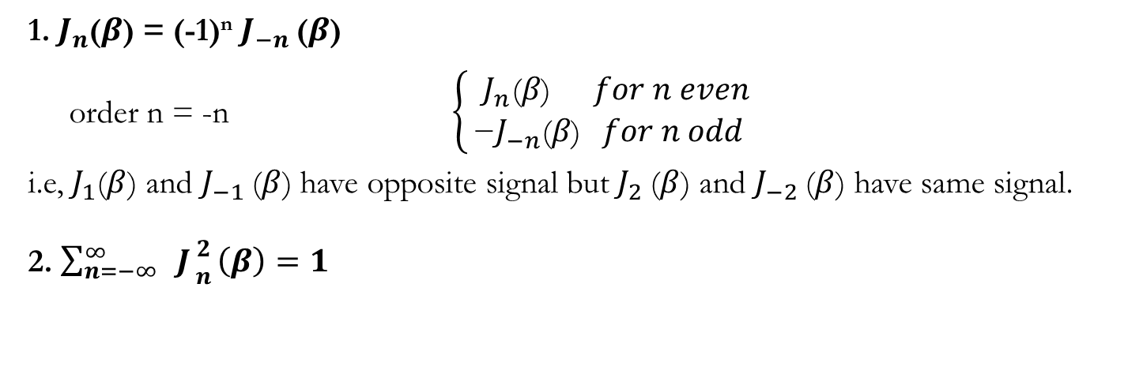
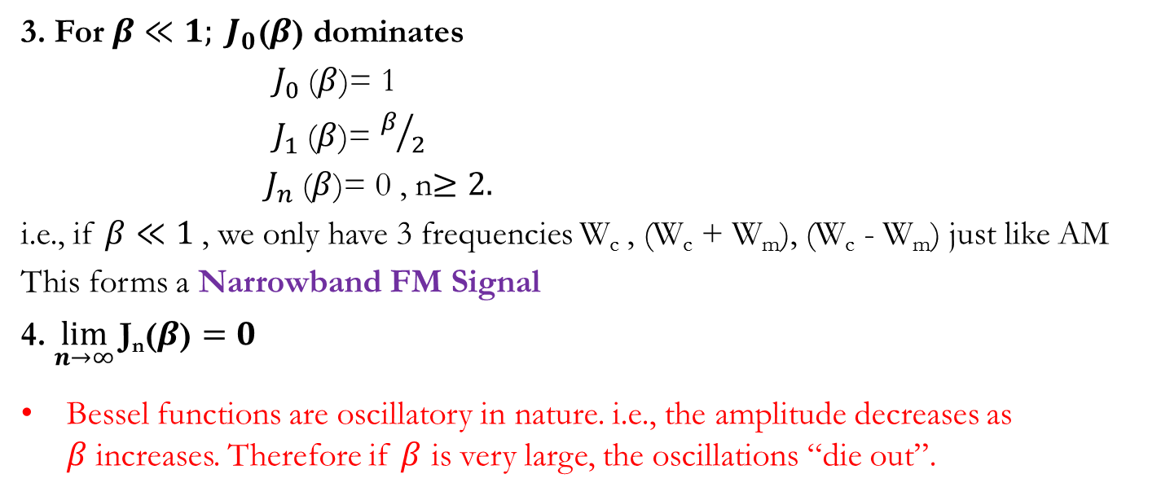
Useful facts about Bessel functions
1. $J_{n}$($β$) = (-1)^{n} $J_{−n}$($β$)
order n = -n $\left\{\begin{aligned}{ J}_{n}\text{(}β\text{)} for n even \\ \text{−}J_{−n}\text{(}β\text{)} for n odd\end{aligned}\right.$
i.e, $J_{1}$($β$) and $J_{−1}$($β$) have opposite signal but $J_{2}$($β$) and $J_{−2}$($β$) have same signal.
2. $\sum_{n=−∞}^{∞}{ J{2 \atop n}\left(β\right)=1}$
3. For $β≪1; J_{0}\text{(}β\text{)}$ dominates
$J_{0}$($β$)= 1
$J_{1}$($β$)= $β/2$
$J_{n}$($β$)= 0 , n$≥2.$
i.e., if $β≪1$, we only have 3 frequencies W_{c} , (W_{c} + W_{m}), (W_{c} - W_{m}) just like AM
This forms a Narrowband FM Signal
4. $\lim_{n→∞}{\text{J}\text{n}\text{(}β\text{)}=0}$
Bessel functions are oscillatory in nature. i.e., the amplitude decreases as $β$increases. Therefore if $β$ is very large, the oscillations “die out”.

Slide 10
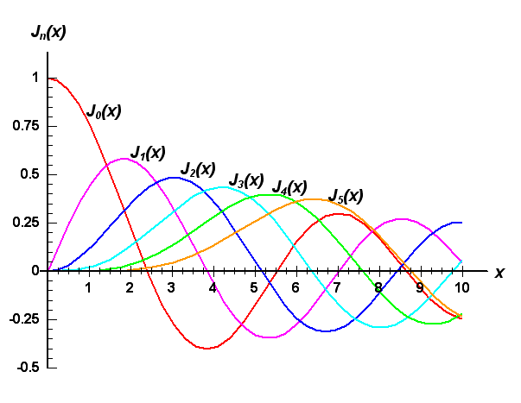
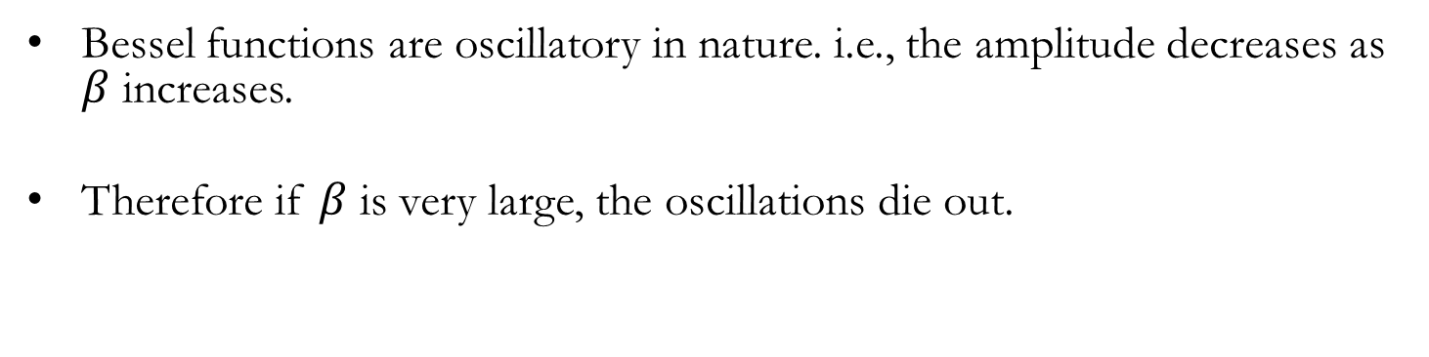

Bessel functions are oscillatory in nature. i.e., the amplitude decreases as $β$ increases.
Therefore if $β$ is very large, the oscillations die out.
Summary Spectral Property
1. Carrier + infinite numbers of sidebands (fc + nfm)
2. Relative amplitudes and number of significant components depends on $β$
3. For $β$<<1, only $J_{0},$ $J_{1}$ are significant: Narrowband FM signal
4. For $β$>>1, wideband FM signal

Slide 11
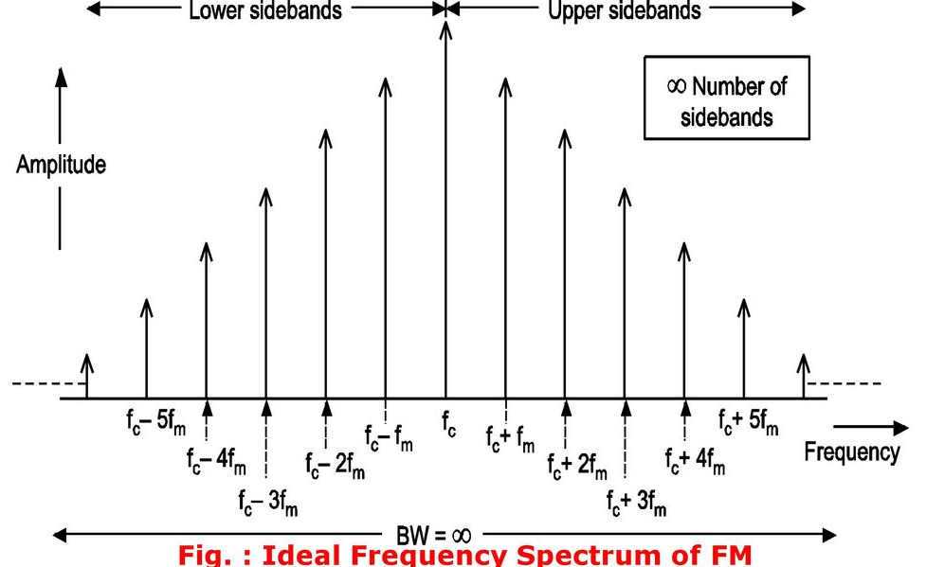
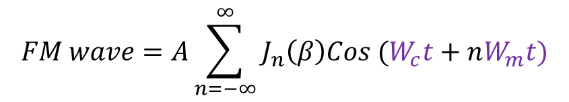

$$FM wave=A\sum_{n=−∞}^{∞}{J_{n}\left(β\right)Cos (W_{c}t+nW_{m}t)}$$
Large spectral components present
If $β≪1 \left(very small\right),$it becomes a narrowband angle modulation
Odd alternate pairs of sidebands (Wc - Wm), and (Wc + Wm) have ${180}^{0}$ phase difference from each other. Same for (Wc - 3Wm) and (Wc + 3Wm) and other odd pairs

Slide 12

BANDWIDTH OF ANGLE MODULATION (QUANTITATIVE)
From previous study, the bandwidth is infinite, but in practice it’s not;
b$ecause \lim_{n→∞}{\text{J}\text{n}\text{(}β\text{)}=0}$
Therefore we have to define a quantitative way to calculate the bandwidth of a practical FM signal:
This is given by the Carson’s Formula shown below:
B = 2 ($β+1) f_{m}$ = 2 $βf_{m}$ + 2 $f_{m}$
= 2 $∆f$ + 2$f_{m}$
where, $∆f$ = $βf$_{m} termed the maximum frequency deviation
NB: this formula used for pure sine waves
What is the power requirements of an FM?

Slide 13
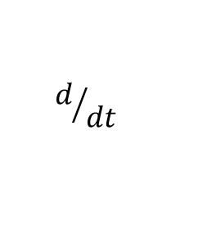
FM Generation and Demodulation
FM can be generated in 2 ways
Direct Method
Indirect Method
The direct method uses a Voltage Controlled Oscillator (VCO).
m(t)
FM
VCO
m(t)
PM
$$d/{dt}$$
VCO

Slide 14
There are 2 main types of VCO: One that use resonance circuits. Where the resonant frequency is proportional to the applied voltage
The other kinds are called a relaxation oscillator or astable multivibrators. These do not use resonant circuits but rely on the ON-OFF switching of transistors
The resonant VCOs produce sine waves while the astable multivibrators produce a square wave

Slide 15
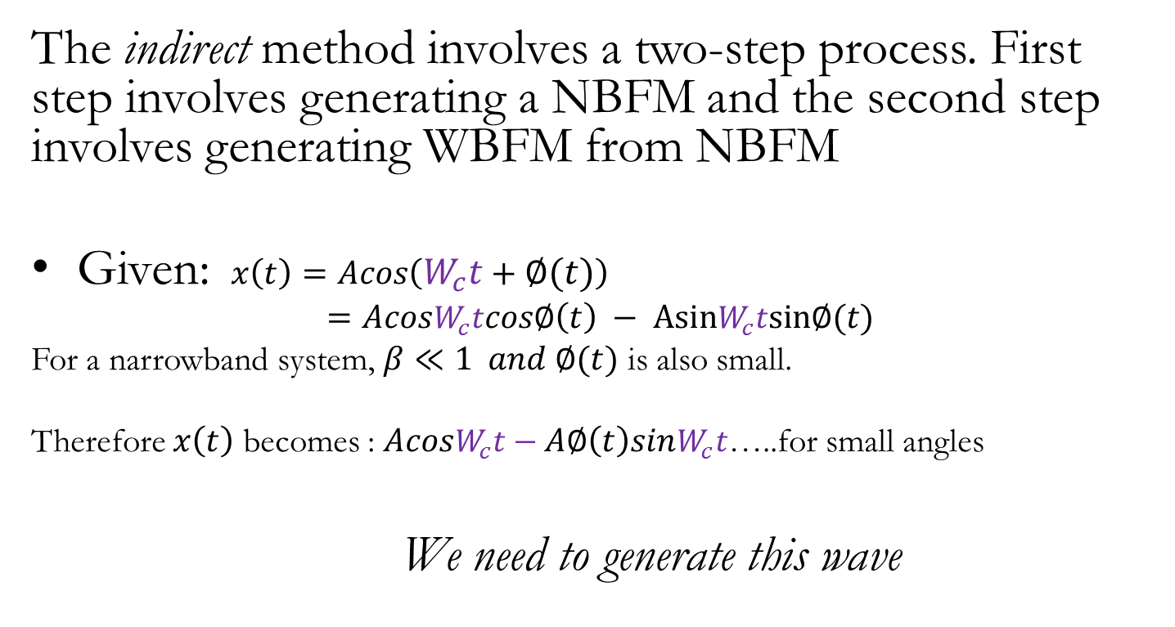
The indirect method involves a two-step process. First step involves generating a NBFM and the second step involves generating WBFM from NBFM
Given: $x\left(t\right)=Acos\left(W_{c}t+∅(t)\right)$
$$=AcosW_{c}tcos∅\left(t\right) − AsinW_{c}tsin∅(t)$$
For a narrowband system, $β≪1 and ∅(t)$ is also small.
Therefore $x\left(t\right)$ becomes : $AcosW_{c}t−A∅\left(t\right)sinW_{c}t$…..for small angles
We need to generate this wave

Slide 16






$Acos\left(W_{c}t\right)$ is the Carrier
$A∅\left(t\right)sinW_{c}t$ is a DSB signal
WHAT MAJOR SETBACK DO YOU NOTICE IN THIS DESIGN?
HOW CAN THIS PROBLEM BE SOLVED?
UPDATE THE ABOVE DIAGRAM TO GENERATE A NBPM SIGNAL?
$$\int_{−∞}^{t}{\left(\right)dt}$$
DSB Modulator (Balanced Modulator)
$$A∅\left(t\right)sinW_{c}t$$
M(t)
+
90$°∅shift$
NBFM
Typical values
$f$_{c1}=200 kHz, $∆f_{1}=25Hz$
͂
Acos$W_{c}t$
Commercial FM Transmission using Armstrong’s Method

Slide 17
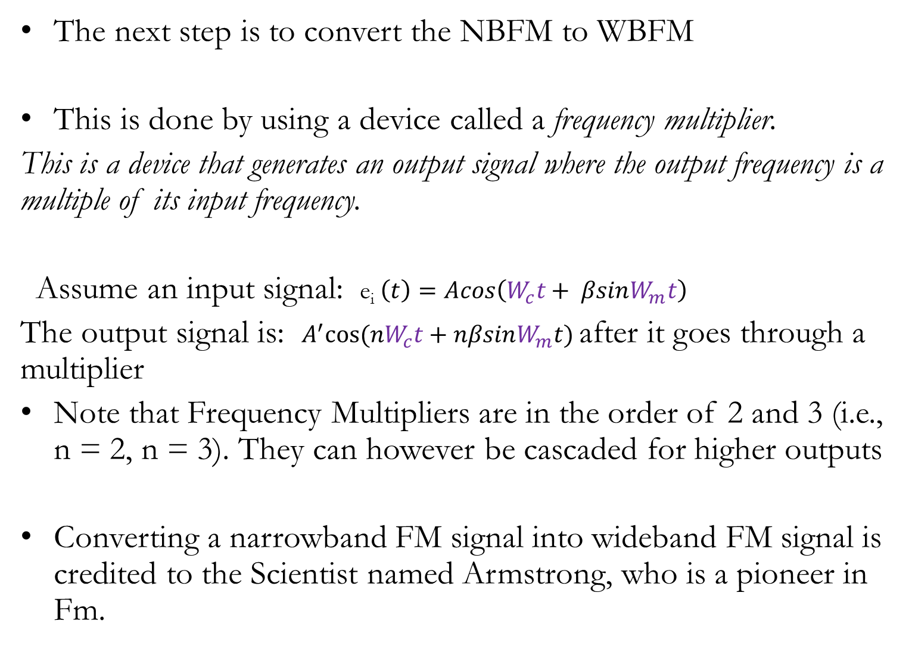
The next step is to convert the NBFM to WBFM
This is done by using a device called a frequency multiplier.
This is a device that generates an output signal where the output frequency is a multiple of its input frequency.
Assume an input signal: e_{i} $\left(t\right)=Acos\left(W_{c}t+ βsinW_{m}t\right)$
The output signal is: $A^{′}cos⁡(nW_{c}t+nβsinW_{m}t)$ after it goes through a multiplier
Note that Frequency Multipliers are in the order of 2 and 3 (i.e., n = 2, n = 3). They can however be cascaded for higher outputs
Converting a narrowband FM signal into wideband FM signal is credited to the Scientist named Armstrong, who is a pioneer in Fm.

Slide 18
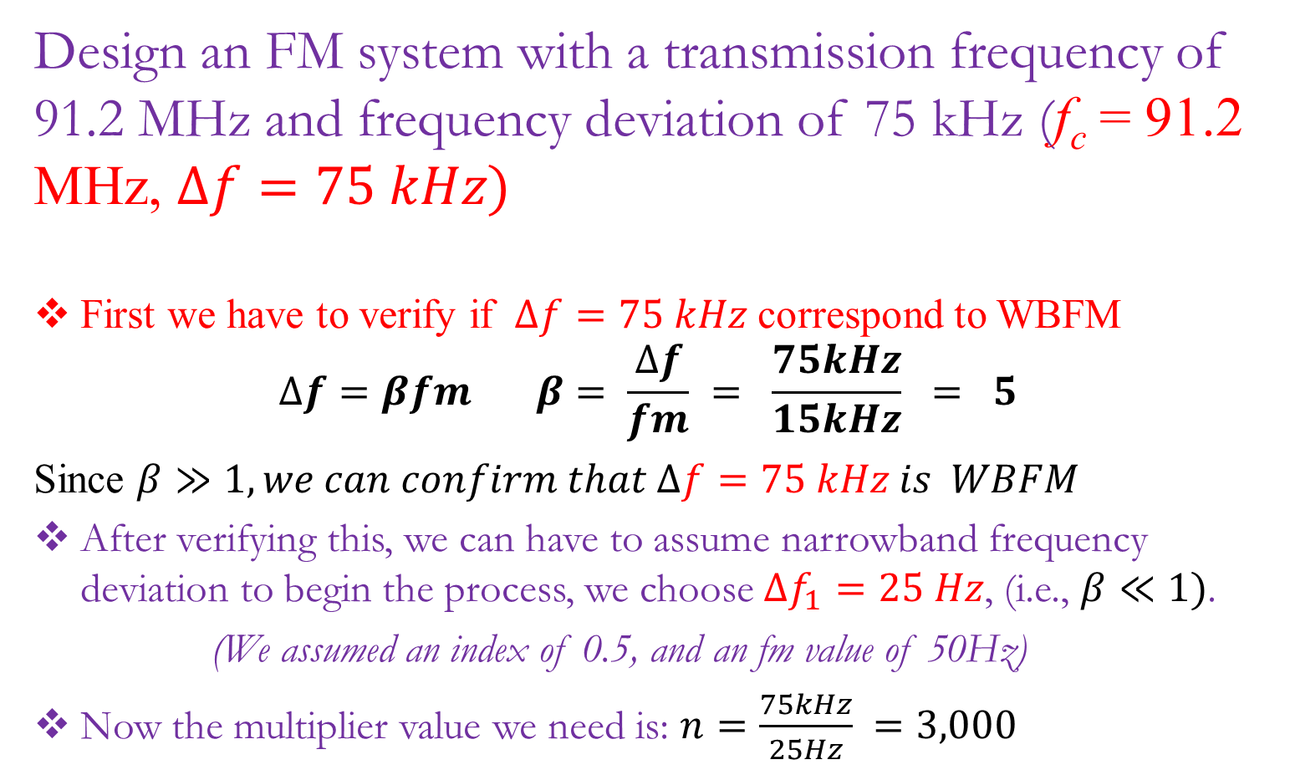
Commercial FM Transmission Design using Armstrong’s Method
Design an FM system with a transmission frequency of 91.2 MHz and frequency deviation of 75 kHz (f_{c} = 91.2 MHz, $∆f=75 kHz)$
First we have to verify if $∆f=75 kHz$ correspond to WBFM
$$∆f=βfm β= \frac{∆f}{fm} = \frac{75kHz}{15kHz} = 5$$
Since $β≫1, we can confirm that ∆f=75 kHz is WBFM$
After verifying this, we can have to assume narrowband frequency deviation to begin the process, we choose $∆f_{1}=25 Hz$, (i.e., $β≪1)$.
(We assumed an index of 0.5, and an fm value of 50Hz)
Now the multiplier value we need is: $n=\frac{75kHz}{25Hz} =3,000$

Slide 19
As stated earlier, multipliers are usually of order 2, 3. Hence to achieve n = 3000, we have to cascade
3000 = (64) * (48)
= (2⁶) * (2⁴ * 3) = 3072
By using 10 doublers and 1 tripler, we can convert a narrowband frequency deviation of 25 Hz into the wideband frequency deviation of 75 kHz
Now how do we handle the carrier frequency, f_{c} , conversion?
Similarly, a frequency multiplier of the same value must be used to convert the carrier frequency but we will encounter challenges
Note that typical values of the carrier frequency, f_{c} , are around 200kHz. Hence let us assume that as a narrowband starting carrier frequency. Hint: It should be higher than the highest frequency of typical baseband signals

Slide 20












Now after multiplication f_{c1} = 200kHz by 300, the wideband carrier frequency becomes 600MHz. This is far greater than what we desire, i.e., 91.2 MHz.
How do we solve this problem? We have to employ the use of frequency translators. Let us look at the diagram below
$f$_{c1}=200kHz
$f$_{c2}=12.8MHz
$f$_{c3}=1.9MHz
$f$_{c4} = 91.2MHz
NBFM
× 64
Frequency convertor (mixer)
× 48
$$∆f_{1}=25Hz$$
$$∆f_{2}=1.6kHz$$
$$∆f_{3}=1.6kHz$$
$$∆f_{4}=76.8kHz$$
$$β_{1}=0.5$$
$$β_{2}=32$$
Local Oscillator
$$β_{3}=32$$
$$β_{4}=1546$$
antenna
Power amplifier
10.9MHz
Commercial FM Transmission using Armstrong’s Method

Slide 21
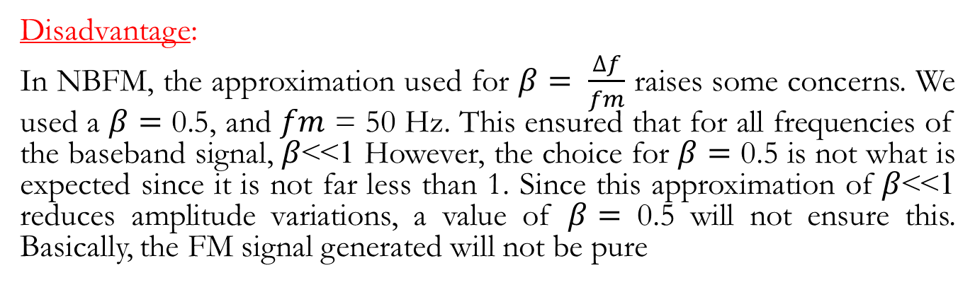
Advantages/Disadvantages of Indirect Method
Advantage:
Frequency Stability:
Frequency generated depends on L and C. At high freq and other factors, their resonant frequency may drift. In most communication systems, we prefer a stable carrier frequency.
In indirect FM, a crystal oscillator can be used in the narrowband FM stage. A crystal oscillator is quartz crystal oscillator than can provide a stable frequency without drifting. This can be used in the NBFM generation. This will ensure that the carrier frequency will remain unchanged even during the wideband phase.
NB: A crystal oscillator cannot be used in direct FM generation.
Disadvantage:
In NBFM, the approximation used for $β= \frac{∆f}{fm}$ raises some concerns. We used a $β=$ 0.5, and $fm$ = 50 Hz. This ensured that for all frequencies of the baseband signal, $β$<<1 However, the choice for $β=$ 0.5 is not what is expected since it is not far less than 1. Since this approximation of $β$<<1 reduces amplitude variations, a value of $β=$ 0.5 will not ensure this. Basically, the FM signal generated will not be pure

Slide 22
Advantages/Disadvantages of the Direct Method
Advantage:
Direct FM produces Wide Band FM directly without going through stages
Disadvantage:
Frequency Instability:
Since we require a Voltage Controlled Oscillator (VCO), a crystal oscillator cannot be used. This means the generated carrier frequency is liable to drift

Slide 23
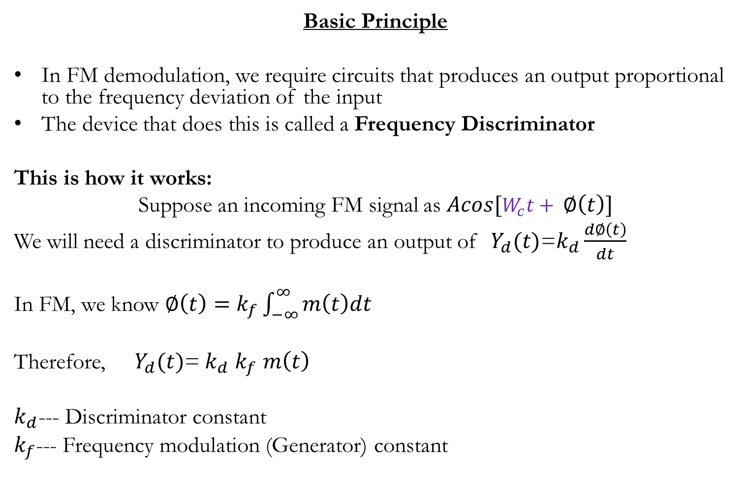
FM Demodulation
Basic Principle
In FM demodulation, we require circuits that produces an output proportional to the frequency deviation of the input
The device that does this is called a Frequency Discriminator
This is how it works:
Suppose an incoming FM signal as $Acos[W_{c}t+ ∅\left(t\right)]$
We will need a discriminator to produce an output of $Y_{d}(t)$=$k_{d}\frac{d∅\left(t\right)}{dt}$
In FM, we know $∅\left(t\right)=k_{f}\int_{−∞}^{∞}{m\left(t\right)dt}$
Therefore, $Y_{d}(t)$=$k_{d}$ $k_{f}$ $m\left(t\right)$
$k_{d}$--- Discriminator constant
$k_{f}$--- Frequency modulation (Generator) constant

Slide 24
An ideal characteristics of a discriminator is shown below
Explain what this graph represents for a frequency discriminator?
What is the slope of this graph?
Can I use a frequency discriminator to demodulate a PM wave? How?
Output voltage
f_{c}
Input frequency

Slide 25





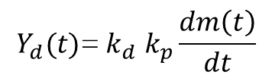
Now to demodulate PM signals using a frequency demodulator. All we need is to introduce an integrator after the frequency discriminator
PM
Freq Discriminator
$$Y(t)$$
$$\int{.}$$
$$Y_{d}(t)$$
Signal
$$Integrator$$
$$Y_{d}(t)\text{=} k_{d} k_{p}\frac{dm\left(t\right)}{dt}$$
$Y_{d}(t)$=$k_{d}$ $k_{p}$ $m\left(t\right)$

Slide 26


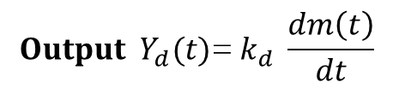


How do we realize an ideal discriminator ?
What circuit or device can realize an ideal discriminator?
It is impossible to combine circuits to give us the characteristics of an ideal discriminator.
However, we can combine circuits to approximate this ideal behaviour as shown below
Differentiator
e(t)
Envelope detector
$$X_{R}(t)$$
$$Y_{d}(t)$$
Frequency Discriminator
Incoming FM signal, $X_{R}= Acos[W_{c}t+ ∅\left(t\right)]$
After going through differentiator e(t) $= −A\left(Wc+ \frac{d∅\left(t\right)}{dt}\right)\sin\left[W_{c}t+ ∅\left(t\right)\right]$
$${Output Y}_{d}(t)\text{=} k_{d} \frac{dm\left(t\right)}{dt}$$
$k_{d}$= A

Slide 27

There may be a few setbacks with this approximation
Input signal may have some amplitude variation due to the channel noise
This means that the differentiator will also see the amplitude as a time varying amplitude and differentiate it as well
To solve this problem, we need to make sure that the input FM signal to the receiver has a constant amplitude. How can we realize this?
The constant amplitude requirement above can be met by using a device called a LIMITER, also called a BANDPASS LIMITER. Or HARD LIMITER
v_{O}
1
v_{I}
$$X_{R}$$
LIMITER
Band Pass Filter
The band pass filter is added
to a limiter to convert the
square wave back to a sine wave. The addition of this two is called a hard limiter
OUTPUT out of Limiter
INPUT into Limiter

Slide 28



Therefore the realization of an ideal characteristics of a Demodulator is shown below
$$X_{R}$$
Limiter
Bandpass Filter
$$\frac{d}{dt}$$
Envelope Detector
$$m\left(t\right)$$
Hard Limiter: Kills the amplitude variations and restores sine nature of input wave
Discriminator: Extracts our desired message signal from the incoming FM wave
How can we realize a differentiator?
Use a Time delay (delay line realized using an inductor
Use a band pass filter(s) and approximate a section to be linear

Slide 29
Feedback Demodulators
Other types of demodulators are called Feedback demodulators. These do not use tuned circuits as compared to the other demodulators.
They have some advantages compared to the other types of demodulator:
They yield better performance in the presence of noise
It is widely used
Can be easily realized in integrated circuit form (IC’s)
A common kind of feedback modulator is the Phase Locked Loop (PLL)
Note that PLL is not just used for FM demodulation. It has a wide range of applications in electronics.

Slide 30





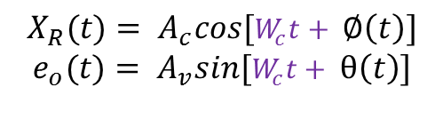
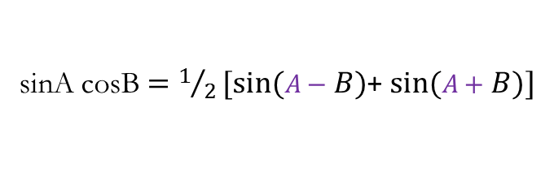

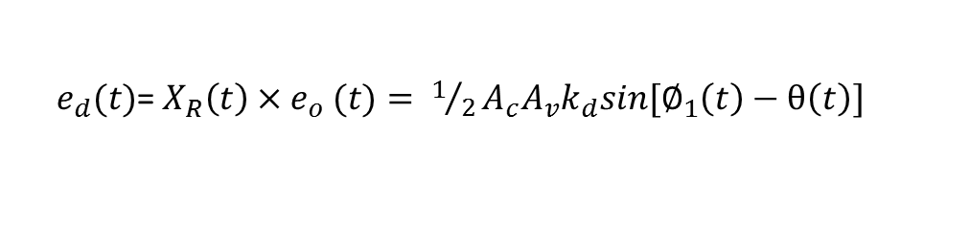
The PLL has four basic components
Phase detector
Loop Filter
Loop Amplifier
Voltage Controlled Oscillator (VCO)
$$X_{R}(t)$$
Loop Amp (gain)
Phase detector
Loop filter
$$e_{v}(t)$$
$e_{o}(t$)
VCO
Phase detector: a phase detector is a combination of a multiplier and a low pass filter
$$X_{R}(t)$$
multiplier
LPF
$$e_{d}(t)$$
$$X_{R}(t)= A_{c}cos[W_{c}t+ ∅\left(t\right)]$$
$$e_{o}(t)= A_{v}sin[W_{c}t+ θ\left(t\right)]$$
$$e_{o}(t)$$
Output of phase detector::
$e_{d}(t)$= $X_{R}\left(t\right){×e}_{o}(t)=$ $1/2A_{c}A_{v}k_{d}sin[∅_{1}\left(t\right)−θ\left(t\right)]$
Using::
sinA cosB $=1/2[sin⁡(A−B)$+ $sin⁡(A+B)]$

Slide 31



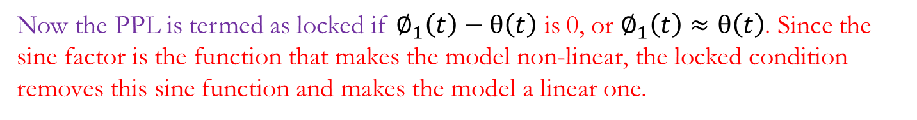

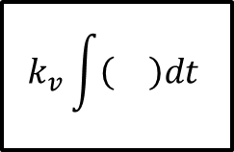



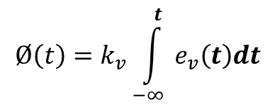

VCO: For a VCO, the frequency deviation at its output should be proportional to the input signal
$\frac{dθ\left(t\right)}{dt}$ α input signal
$\frac{dθ\left(t\right)}{dt}$ = $k_{v}{ e}_{v}(t){ , k}_{v}=VCO constant$
$$Ø\left(t\right)=k_{v}\int_{−∞}^{t}{{ e}_{v}\left(t\right)dt}$$
Mathematical Model of the PLL (Non Linear)
$$e_{d}(t)$$
$$∅(t)$$
Sin ( )
$$1/2A_{c}A_{v}k_{d}$$
Loop filter
+
–
$$θ\left(t\right)$$
$$k_{v}\int{\left(\right)dt}$$
$$e_{v}(t)$$
Loop Amp
Now the PPL is termed as locked if $∅_{1}\left(t\right)−θ\left(t\right)$ is 0, or $∅_{1}\left(t\right)≈θ\left(t\right)$. Since the sine factor is the function that makes the model non-linear, the locked condition removes this sine function and makes the model a linear one.

Slide 32
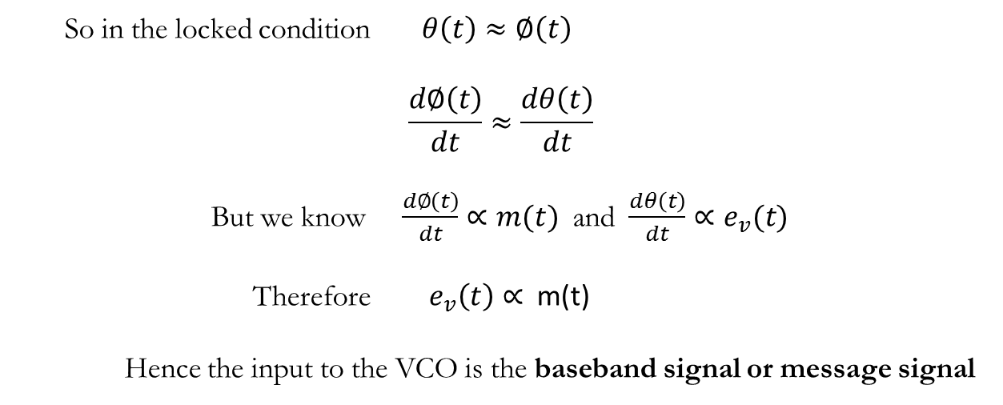
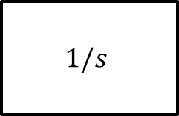





Mathematical Model of the PLL (Linear)
$$∅(s)$$
$$1/2A_{c}A_{v}k_{d}$$
Loop filter
+
–
$$θ\left(s\right)$$
$$1/s$$
$$e_{v}(s)$$
Loop Amp
So in the locked condition $θ\left(t\right)≈∅\left(t\right)$
$$\frac{d∅\left(t\right)}{dt}≈\frac{dθ\left(t\right)}{dt}$$
But we know $\frac{d∅\left(t\right)}{dt}∝m(t)$ and $\frac{dθ\left(t\right)}{dt}∝e_{v}(t)$
Therefore $e_{v}\left(t\right)∝$m(t)
Hence the input to the VCO is the baseband signal or message signal
ASSIGNMENT: PRESENT ON HOW IS THE LOCKED ACHIEVED IN THE PPL

Slide 33
ASSIGNMENT
PREPARE A DETAILED PRESENTATION ON THE DIFFERENCES BETWEEN AM AND FM

